Slide 1
computing apprenticeships BDATS INDUCTION
Computing | Science & Engineering
Solent University - Southampton
martin.reid@solent.ac.uk

Slide 2

Martin Reid
Course Leader & Apprenticeship Programme Manager BSc (Hons) Digital and Technology Solutions (Apprenticeships), and Course Leader for Computing Foundation, BSc (Hons) Digital Design and Development, and MSc Digital Design
Office: JM506
martin.reid@solent.ac.uk
Computing | Science & Engineering
Solent University - Southampton

Slide 3
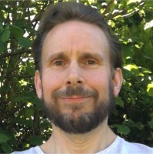
KENTON WHEELER
Associate Lecturer in Computing
Office: JM506
kenton.wheeler@solent.ac.uk
Computing | Science & Engineering
Solent University - Southampton

Slide 4


Welcome
Solent University Campus Requirements of the apprenticeship standard Information and communication Introduction to the academic delivery Grading and assessments Portfolio Off the job tracker Review meetings Gateway endpoint assessment (EPA) Student support Q & A

Slide 5
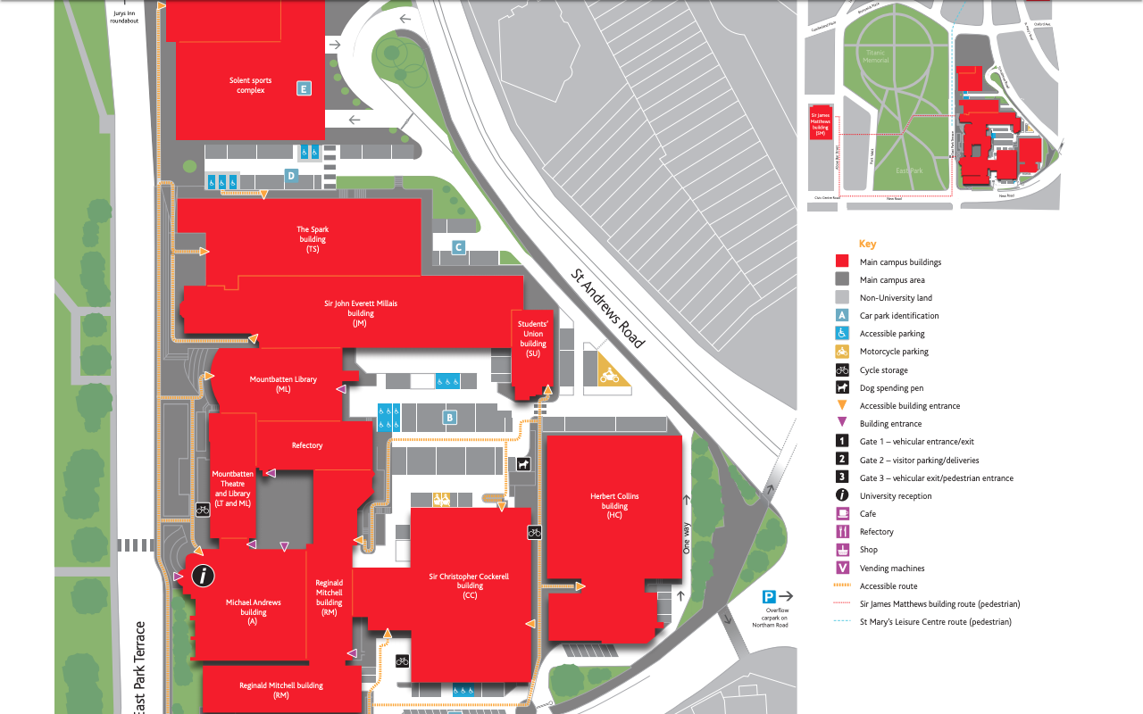
JM Building
Computing Staff Team
JM506
Students
Union

Slide 6
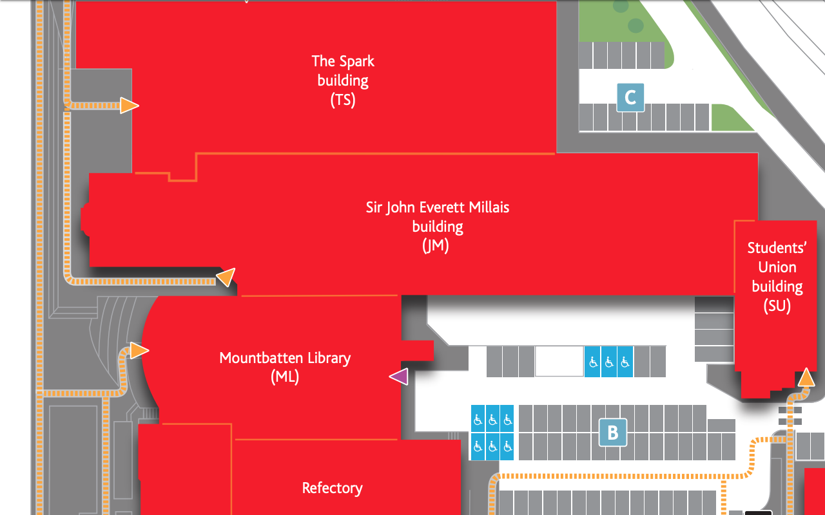

Slide 7
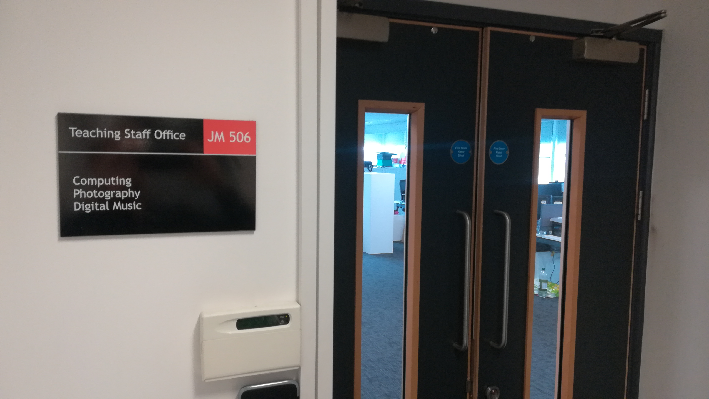
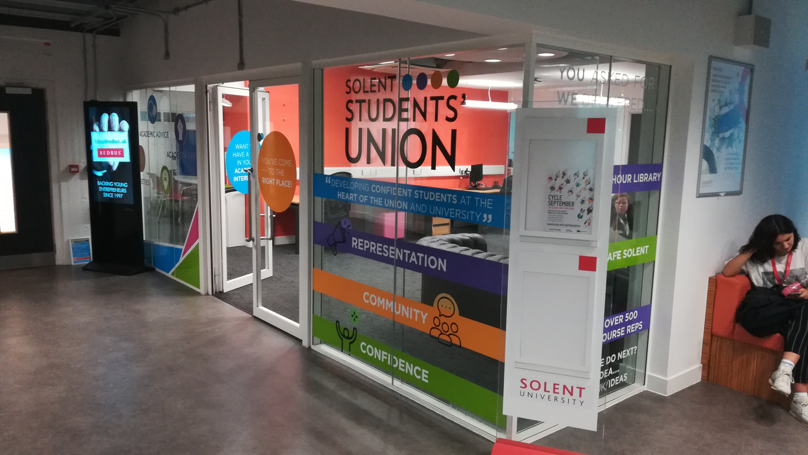
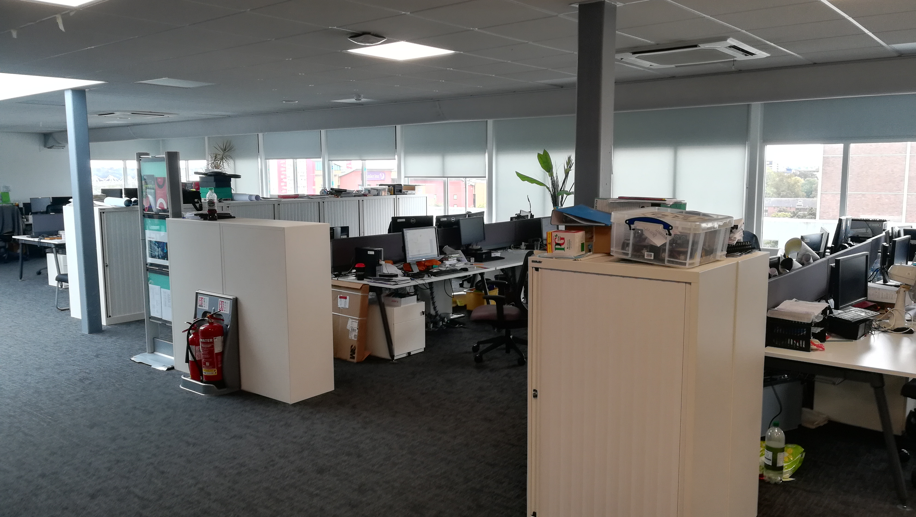
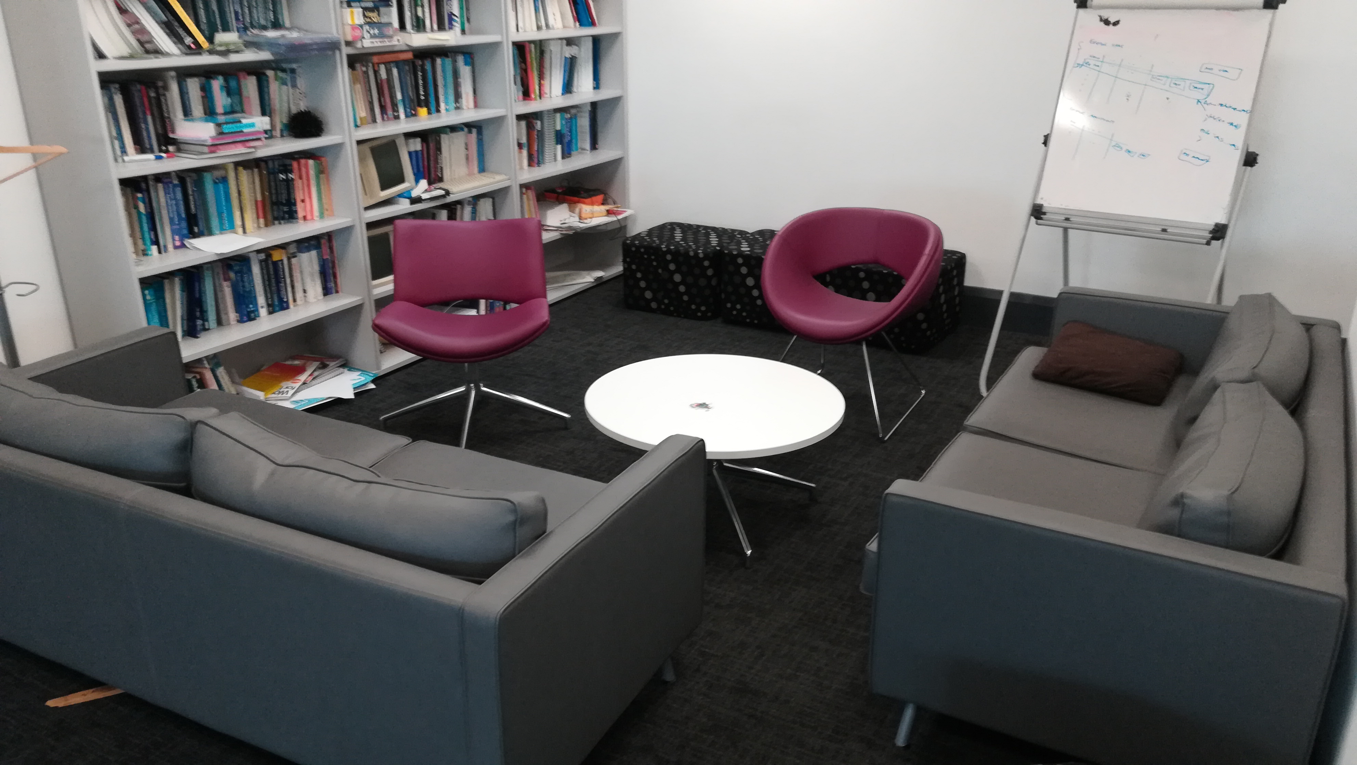

Slide 8

Data Analyst The primary role of a data analyst is to collect, organise and study data to provide new business insight to a range of stakeholders. They are responsible for leading the provision of up-to-date, accurate and relevant data analysis for the organisation.

Slide 9

Cyber Security Analyst A Cyber Security Analyst leads in the work to define, implement and maintain security products and systems within an organisation’s policies and service level agreements

Slide 10

Software Engineer The primary role of the Software Engineer is to undertake all requirements during the solution development life-cycle from gathering requirements to analysis, design, code, build, test, implementation and support.

Slide 11
Network Engineer The primary role of a network engineer is to lead in the planning, design , installation, maintenance and support of communication networks within an organisation or between organisations

Slide 12
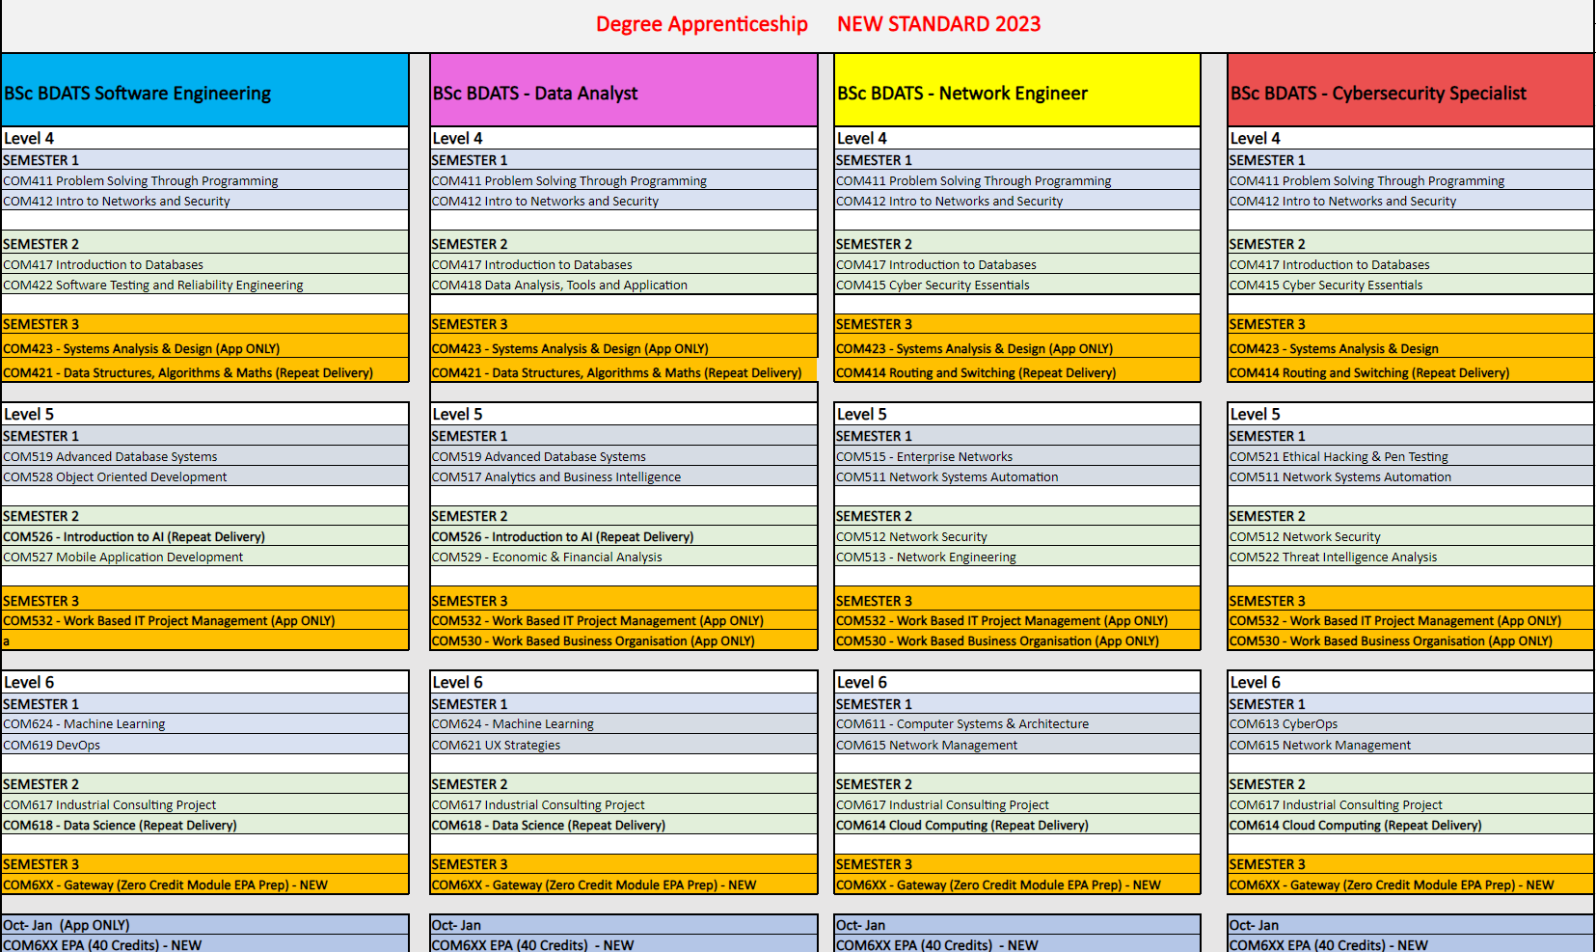

Slide 13

Commitment statement - Learning Plan This is a tripartite agreement between the employer, apprentice and the University
It details:
The course content and schedule
what is expected and offered by the employer, the training provider and the apprentice
how to resolve queries or complaints
agreement for negotiated costs with your employer and the endpoint assessment organisation

Slide 14
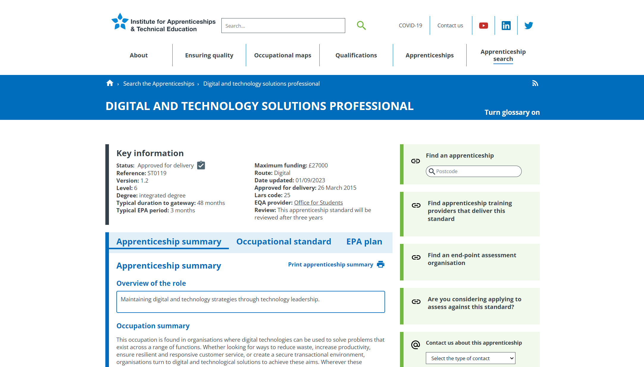
https://www.instituteforapprenticeships.org/apprenticeship-standards/digital-and-technology-solutions-professional-integrated-degree/

Slide 15
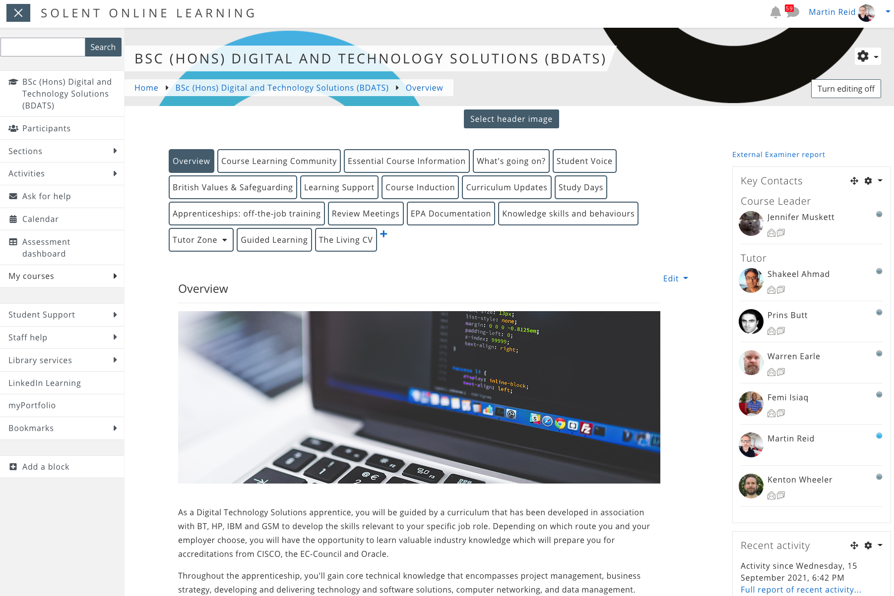
https://learn.solent.ac.uk/course/view.php?id=42080&section=0#tabs-tree-start

Slide 16
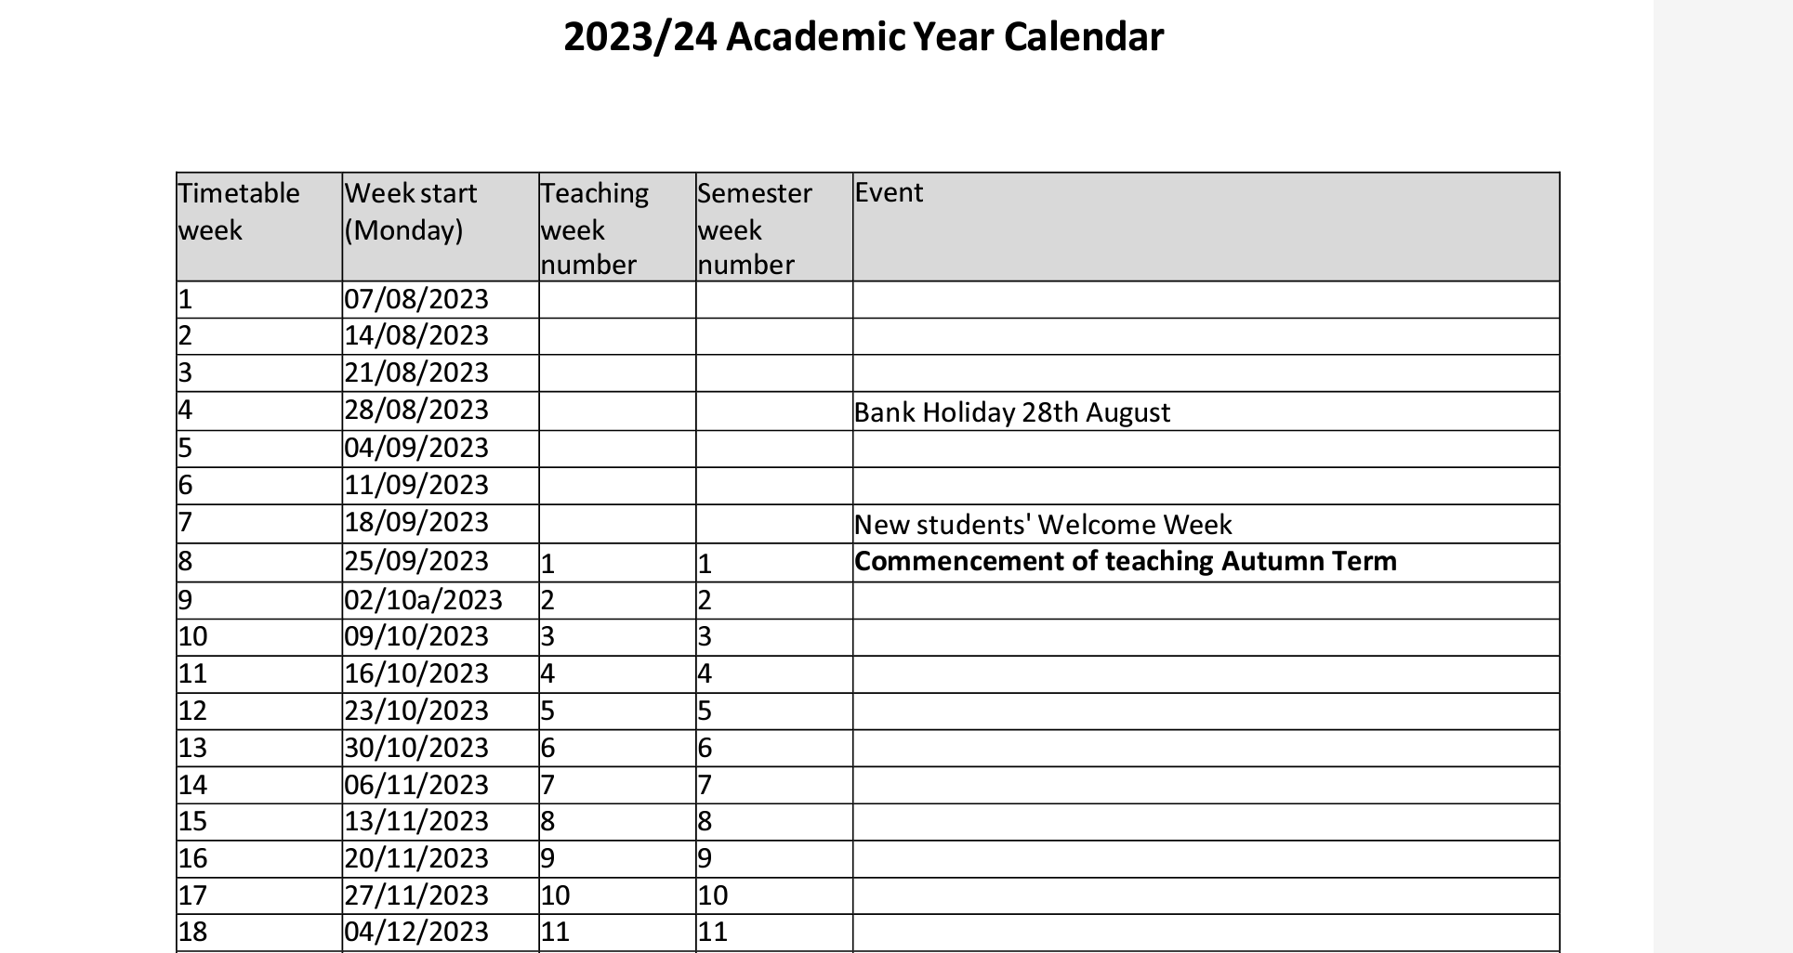
https://students.solent.ac.uk/official-documents/policy-governance-and-information/academic-calendar-2023-24.pdf

Slide 17
Digital and Technology Solutions (integrated degree)
36 Months – on-programme
3 Semesters Study 2 modules at a time (except the final 2 semesters) 3 Months – Gateway EPA

Slide 18
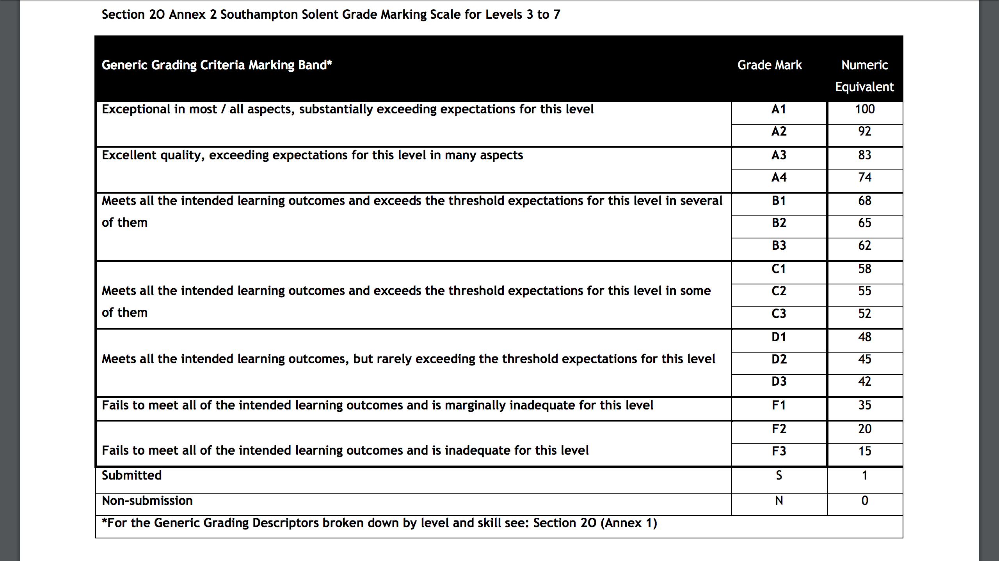

Slide 19
Grades from first year (Level 4) do not count to your final degree classification
D3 & above is a pass for coursework or average out with the numeric equivalent of 40 to pass a Module

Slide 20

PORTFOLIO

Slide 21

Off the Job Tracker
https://learn.solent.ac.uk/course/view.php?id=42080&section=10#tabs-tree-start

Slide 22
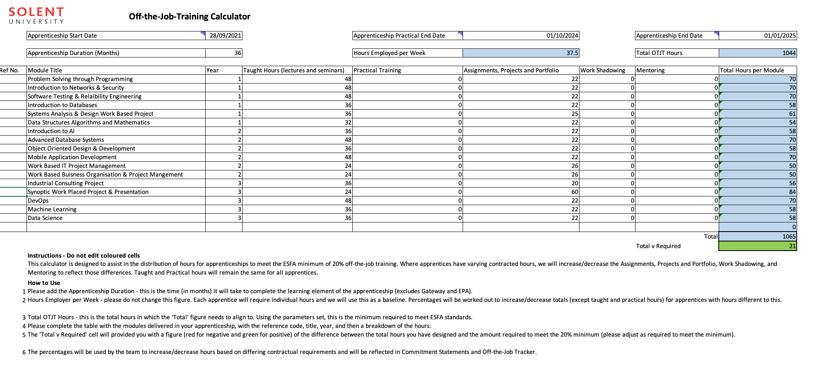

Slide 23
KSB
KNOWLEDGE SKILLS BEHAVIOURS

Slide 24
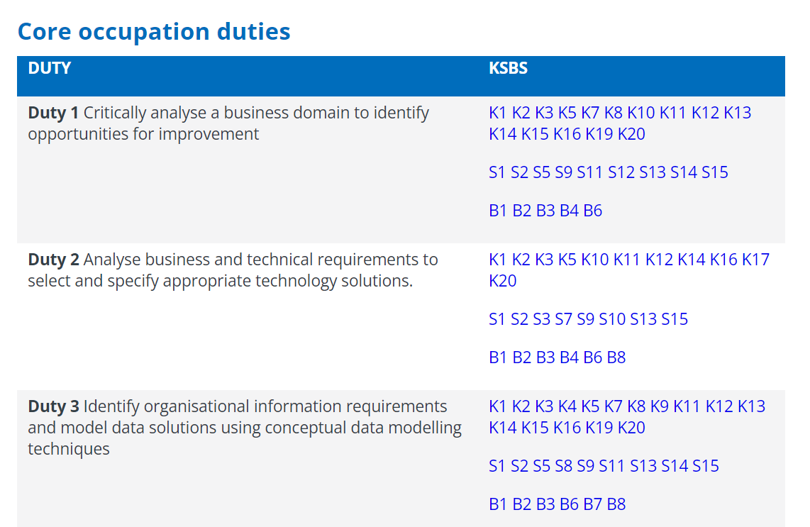

Slide 25
Review meetings
Tripartite review meetings take place regularly throughout the apprenticeship and are usually held every semester.
At tripartite review meetings the apprentice, their employer, and an academic formally meet to assess progress and ensure that the apprentice is on track both in terms of their academic programme and their work-based learning.
https://learn.solent.ac.uk/course/view.php?id=42080&section=11#tabs-tree-start

Slide 26
EPA
Endpoint Assessment
Final 3 months of apprenticeship

Slide 27
Endpoint Assessment – BSc Digital & Technology Solutions
Project Report - AE1 with presentation, questions and answers This assessment method has 2 components: 1. Project with report - 6000 words (+/-10%) 2. Presentation with questions and answers 60 min (Presentation 30mins & 30mins Q&A) Assessment and grading will be undertaken by an independent assessor and be awarded the following grade based upon the criteria written in the standard. The project report with presentation, questions and answers is structured to give the apprentice the opportunity to demonstrate the KSBs.

Slide 28
Endpoint Assessment – BSc Digital & Technology Solutions
Portfolio - AE2 - Professional Discussion underpinned by a portfolio. Professional Discussion – 60 minutes (+10% if necessary) Assessment and grading will be undertaken by an independent assessor and be awarded the following grade based upon the criteria written in the standard. n the professional discussion, an independent assessor and apprentice have a formal two-way conversation. It gives the apprentice the opportunity to demonstrate the KSBs mapped to this assessment method. The apprentice can refer to and illustrate their answers with evidence from their portfolio of evidence (6 items) previously submitted at Gateway.

Slide 29
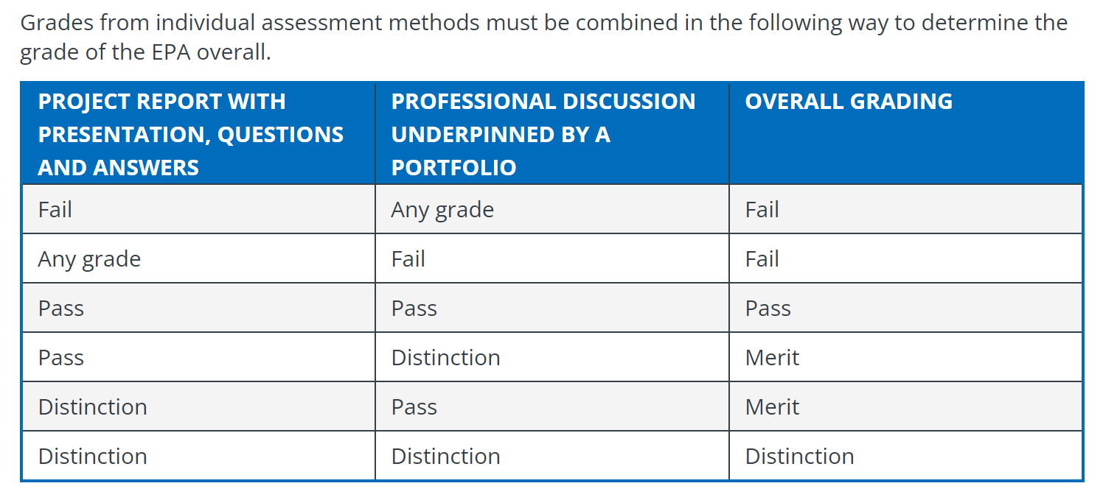

Slide 30
You must pass the degree to pass the apprenticeship and you must pass the apprenticeship to pass the degree

Slide 31
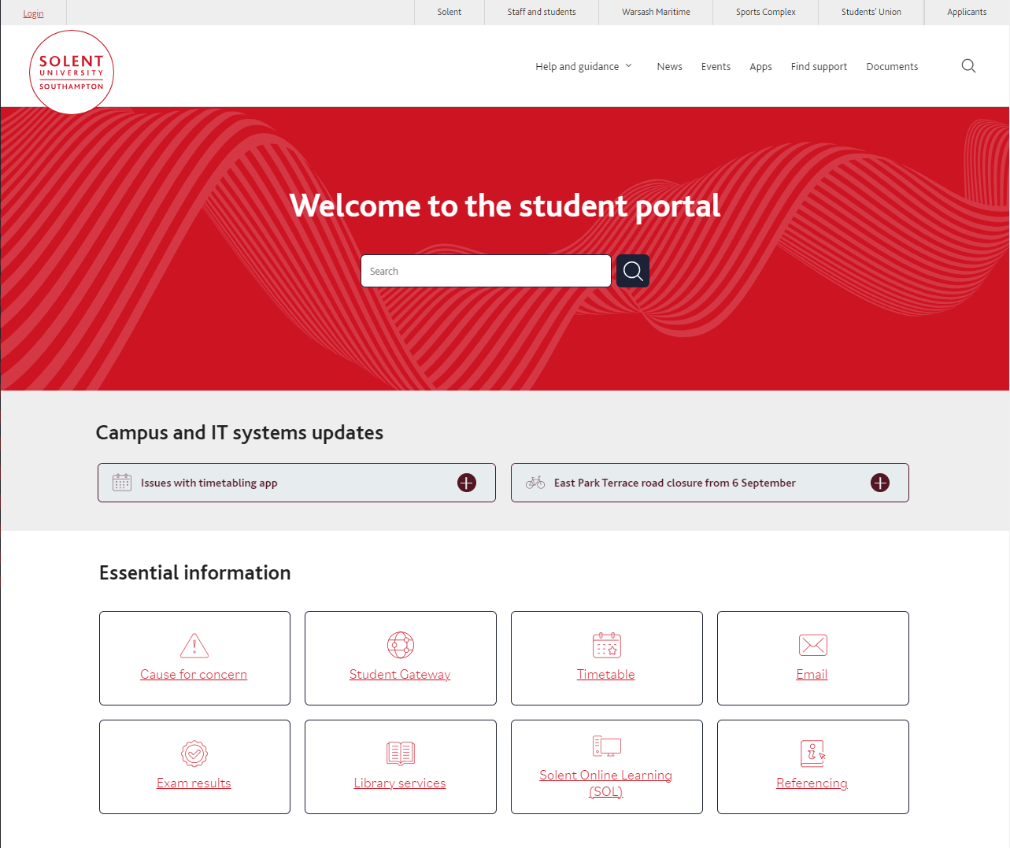
https://students.solent.ac.uk/

Slide 32
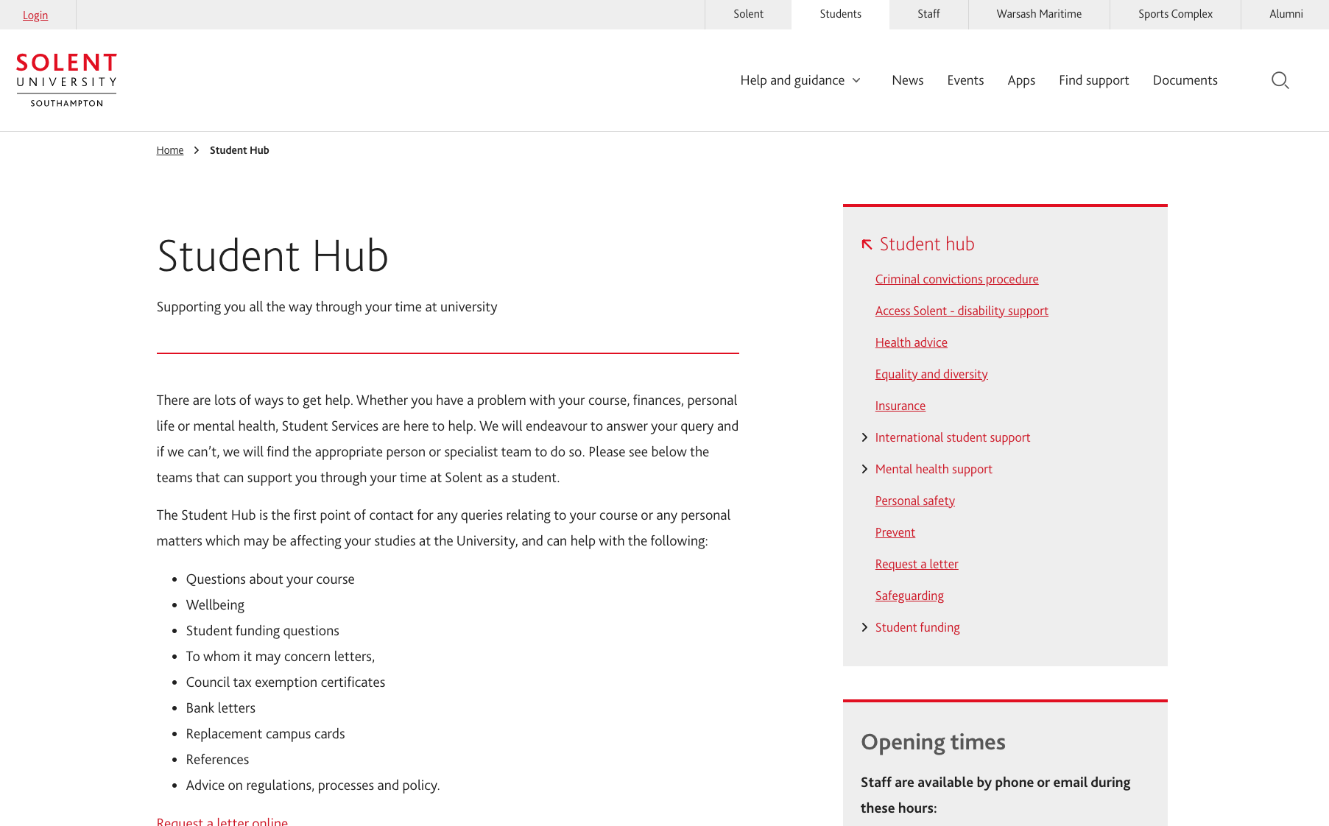
https://students.solent.ac.uk/student-hub

Slide 33

https://students.solent.ac.uk/student-hub/mental-health-support

Slide 34

Thank you & Questions

